Slide 1
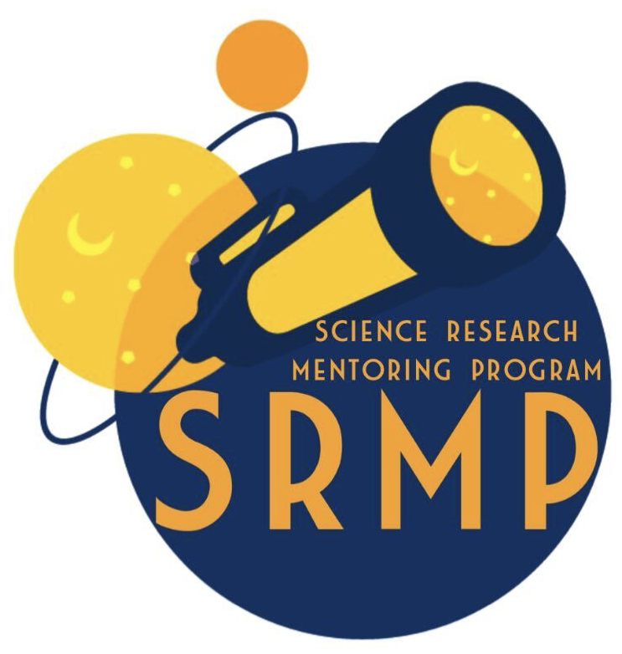
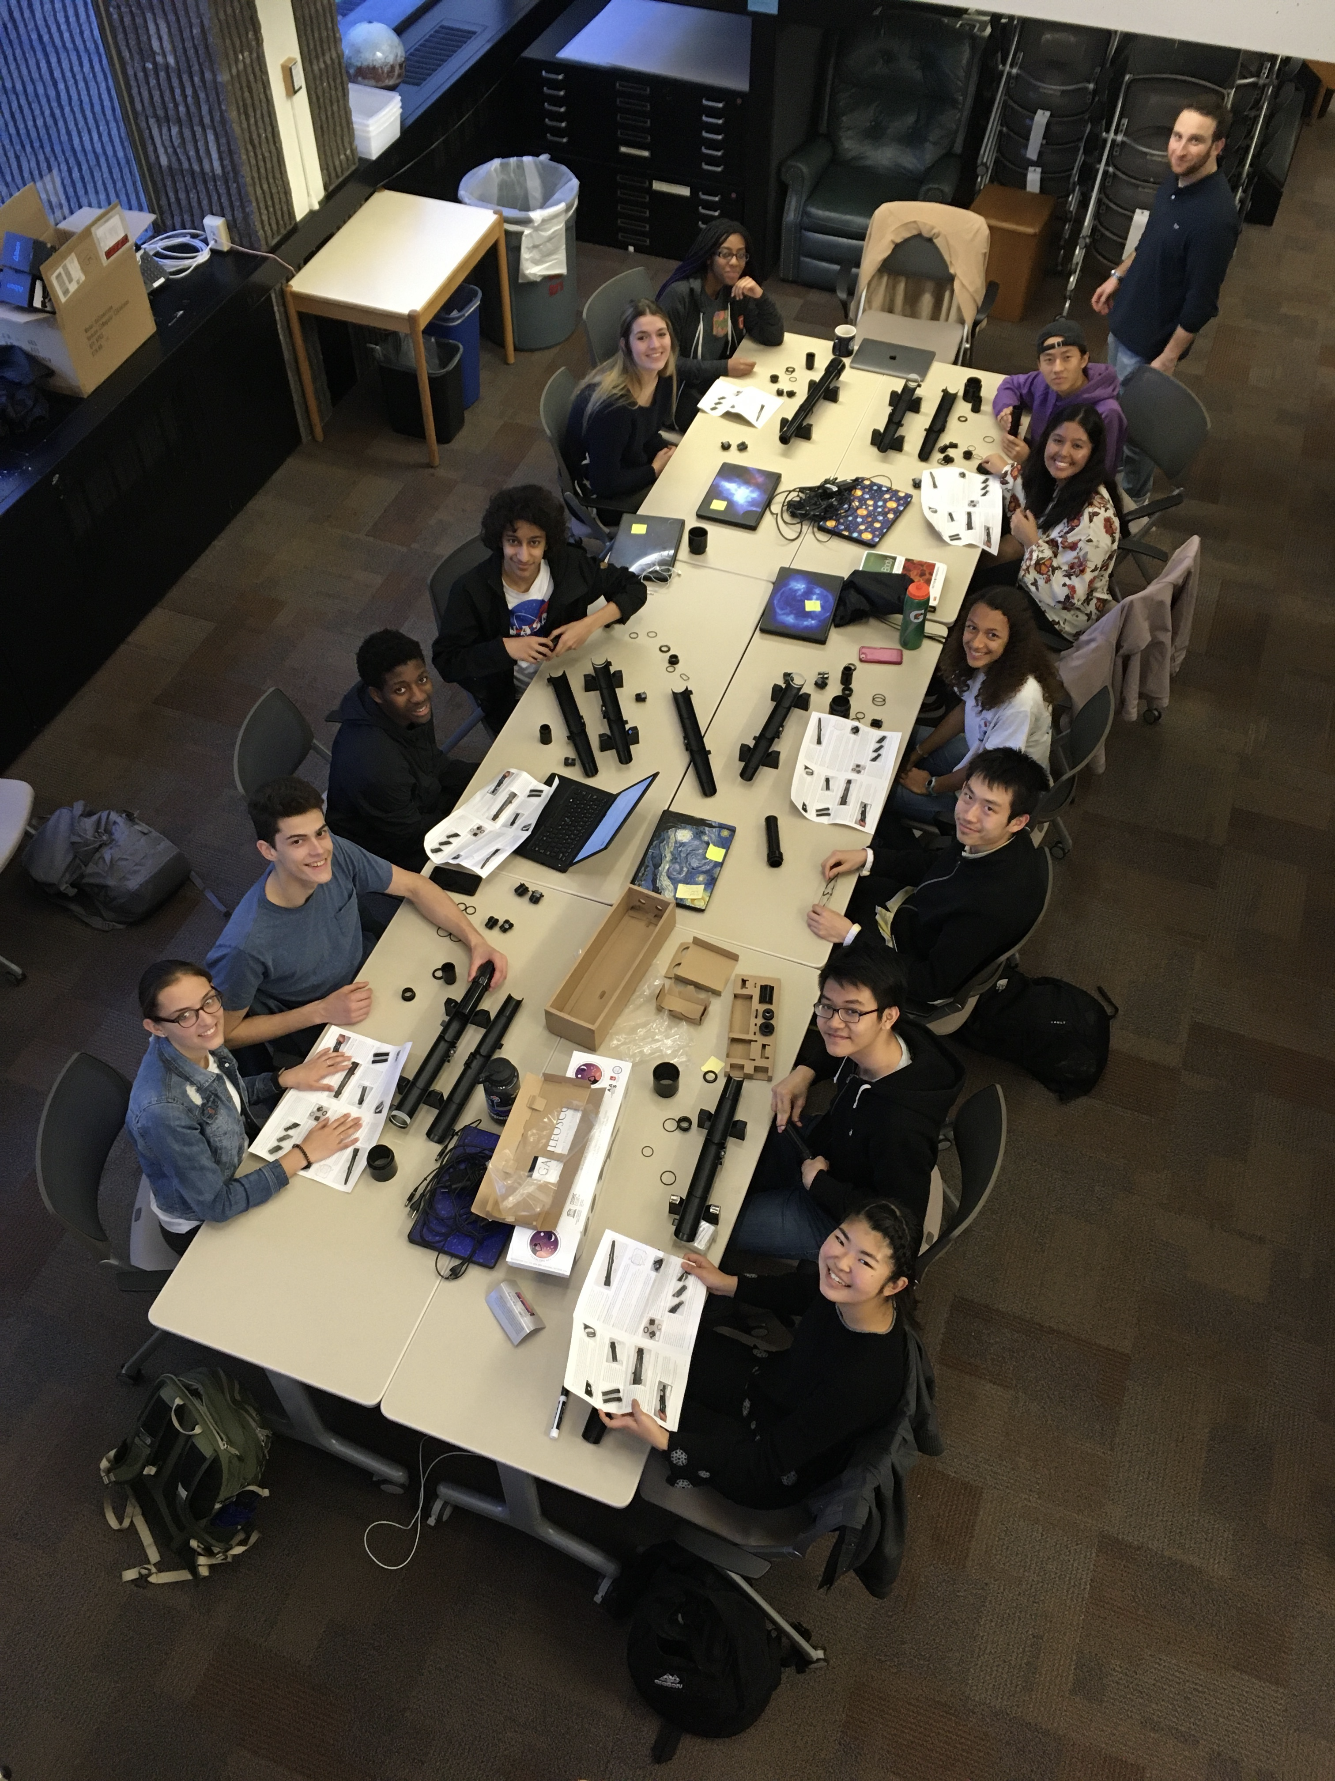
Have you ever wondered about planets, stars, galaxies, or black holes?
Do you want to study our universe with Harvard and MIT scientists?
Join the Harvard-MIT Science Research Mentoring Program (SRMP) and you can!
Applications open May 10 – May 28
SRMP Details:
September 2021- May 2022.
2-4 students meet 2x week for 2 hours with their mentors.
SRMP students are paid for their work!
Requirements:
No prior research experience required → just interest and curiosity!
Applicants must be HS Sophomores, Juniors or Seniors during the 2021-2022 academic year.
Apply here from May 10– May 28!
For more information visit: https://projects.iq.harvard.edu/shrimp
Questions? Please email:
Dr. Clara Sousa-Silva (clara.sousa-silva@cfa.harvard.edu)
Mr. Daniel Yahalomi (daniel.yahalomi@columbia.edu)

